Slide 1
Which One Is to Choose for Enterprise Container Storage: NAS vs. SAN
July 2022

Slide 2
Executive Summary: NAS and SAN Container Storage
Reasons to choose container storage: NAS vs SAN
#1 reason is application type, other reasons includes ease of O&M, reuse existing SAN/NAS, and orchestration integration etc.
NAS (object storage can also support these applications, the main differences are NAS perform better, share better, handle files with various sizes better)
Big data analytics
ML and deep learning
Video streaming and analysis
DevOps……
SAN
Database
New applications with large datastore, such as ElasticSearch, Casandra, and Couchbase.
NAS and SAN container storage typical use cases
NAS
Industry: MSP, Streaming Services, Health Care, and ADAS etc.
Applications: Big data analytics, ML/DL, Video Analysis and DevOps etc.
SAN
Industry: Banking, government, oil/gas etc.
Applications: RMDB, new application with large datastores like ElasticSearch etc.
Why haven’t I heard many NAS/SAN (especially from IT vendors) container storage use cases?
Adoption stage: enterprises move quickly to modernize their applications first to containers, while data containerization for stateful application are still maturing
Many started with public cloud object storage first: since new application types like BDA, ML/DL etc. fit well with S3 type of object storage, naturally you will see more use cases in object storage, BUT, customers gradually found that the cloud object storage can’t perform at the enterprise-grade, thus they are looking for new solutions, NAS and SAN become more popular with some high sharing, various file sizes, and mission critical.
Public cloud competitions: public cloud provide end-to-end services including Kubernetes/OpenShift/Tanzu clusters, serverless-based data services, application , app integrations (like app consistency support), thus IT vendors must find other advantages to compete, by providing specialized data services
NAS and SAN are valid choice, what are market and product strategy to promote NAS and SAN container storage from IT vendors?
Provide specialized premium data services: to compete with cloud vendors like AWS® EFS (file) and EBS (block), IT vendors must take advantages of faster hardware innovation cycles, provide premium services in new hardware like flash technologies, PMem, CXL, RDMA, xPUs and GPUDirect etc., enterprise-grade data availability, reliability and protections, better data reductions. This kind of products can be called “high-performance enterprise Kubernetes storage NAS”
Improve end-to-end container ecosystem support: it includes deep Kubernetes/OpenShift/Tanzu support, like app/crash consistency, dynamic provisioning, CAS (container attached storage like OpenEBS etc.), observability, storage system data service integration and abstractions (like Container Storage Module) etc.
Continue research and promote near data processing: adding ML algorithm in control path of Kubernetes to better compute/storage coordination’s, resource mapping and optimization etc.
Compete in multi- hybrid- cloud support: IT vendors normally embrace more open systems, comparing to public cloud vendors. This will ease enterprises concern related to vendor lock-in. Container, Kubernetes, and container storage play important role to better support app and data mobility etc.

Slide 3
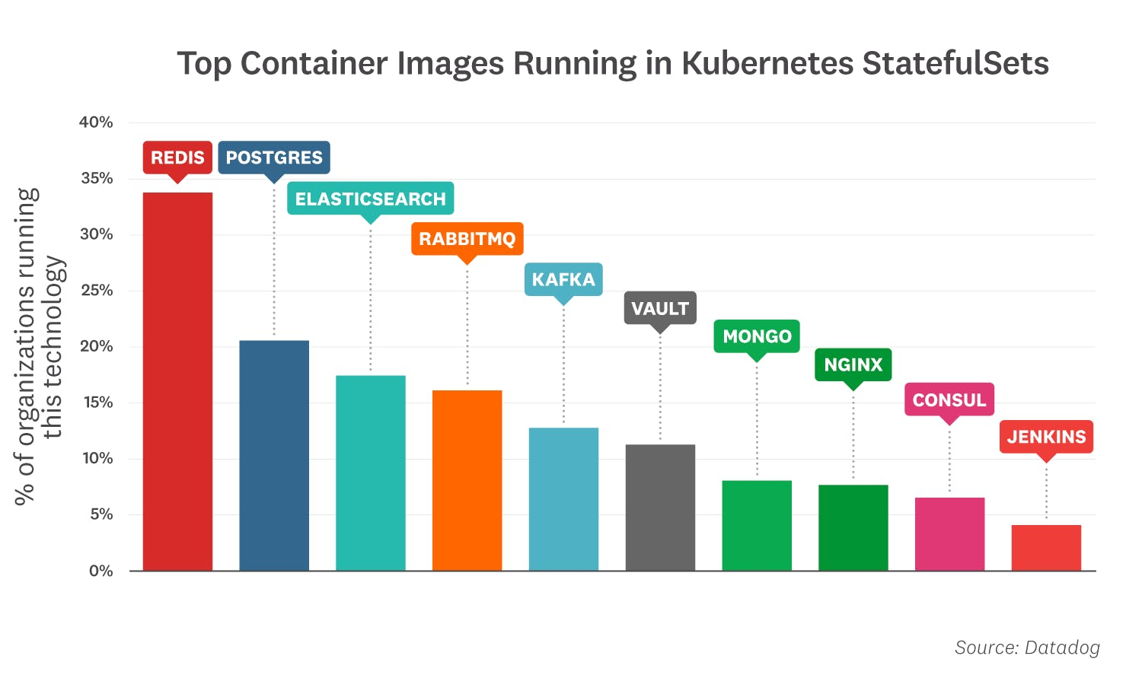
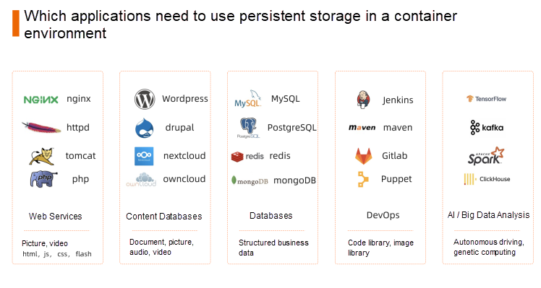
NAS and SAN Container Comparison: Reasons to choose NAS vs. SAN
As of October 2021, the most popular off-the-shelf container images
The application type
SAN: (especially when the size the data in these application are expected to grow big) databases, modern data store platforms like ElasticSearch, Cassandra and Couchbase
NAS: (object and HCI are in the same category) the rest
Operation and maintenance
SAN: harder (might need FC switches)
NAS: easier
Integration with orchestration tools
No difference in choosing SAN and NAS, the full integration wins out (SAN is in general treated as more organic consumption within k8s, similar to VMWare® uses SAN, but NAS doesn’t fall behind too much)
The full integration could mean container-native-storage (software defined, and k8s native like Portworx® to Pure Storage®) on top of the storage array, or array with vendor developed k8s data store and services like NetApp ® Astra
Reusing existing SAN and NAS systems
Leverage your investment in materials and process right away
Also take advantages of rich data services
Acknowledgement: Image source

Slide 4
NAS and SAN Container Comparison: Use Cases Examples
NAS Containers: Industry
Video Service & Industry 4.0 (factory floor video monitoring surveillance)
High concurrency (file sharing), high traffic, low latency (for all flash NAS)
Container and orchestration make the high elastic (peak burst to cloud) possible
ADAS
Training: GPU access pictures in the training set repeatedly and randomly
high-IOPS file access(random access for small files) file access (good for all flash NAS)
Containers to support multiple clients to access multiple data nodes at the same time
Health Care: Bioinformatics & Genome Computing
Real time data from gene sequencer, historical data, intermediate data
All are in file format; some might need GPU access; good for all flash NAS
Container cluster to mount NFS for shared storage of high-performance computing for genome data analysis
MSP: Compete with public loud like AWS Elastic File System (VastData® + Krystal® + Nvidia®)
Cloud giant file services limit performance/TB, all flash NAS can have better performance
Containers are used for multi tenants to share files
NAS Containers: Applications
Web services: Content management applications, such as WordPress, are scaled out to multiple instances for performance and redundancy and can share uploads, plugins, and templates across multiple instances.
Software development tools: Developer tools such as JIRA and Git need to share data between instances to achieve high availability, but the code is kept in multiple Alibaba Cloud zones for persistence.
Big data analysis/processing and Machine/Deep Learning: Machine learning frameworks, such as genetic data processing and Tensorflow, need to access data through file system interfaces and use shared persistent storage. This allows multiple users to use and run jobs on the same set of data in parallel.
Enterprise applications: Shared notebooks (such as JupyterHub) need to provide persistent storage for notebook data and user workplaces, and shared storage makes collaboration easy for data scientists.
SAN Containers
ERP, CRP, DB modernization: Software vendors (SaaS and RMDB) stared to support containerization for cloud-native and elasticity. This could be an opportunity for all flash SAN.
Mainframe modernization: Many public cloud vendors started to provide such service, compute side uses mainframe emulators, the storage side uses containerized database to replace DB2.

Slide 5
NAS and SAN Container Comparison: What features are customers looking for
NAS Container
Multi clients file sharing (one example is VAST Data ® used in MRI image processing, many research teams need to access images files repeatedly)
High performance: All flash, large global cache SCM), GPU (GPUDirect) integration, RDMA (FE&BE)
Versatility: can efficiently handle both large quantities of large files and small files
Many file protocols: many customers prefer NFS support
Unified file and object storage: for different applications, data protection to cloud etc.
Easy and non-disruptive scale-out: adding nodes, or even support cloud burst
K8S/OpenShift deep integration: not just simple CSI integration
Application deep integration (many applications like ES, MongoDB etc. natively replicate data, NAS can take advantage array replication/DR for AA multisite access by applications)
Easy O&M
SAN Container
High performance: All flash, large global cache SCM), GPU (GPUDirect) integration, RDMA (FE&BE)
Extremely high reliability for mission critical applications
Easy and non-disruptive scale-out: adding nodes
K8S/OpenShift deep integration: not just simple CSI integration
Application deep integration
Easy O&M

Slide 6
NSA and SAN Container Comparison: Vendor Offerings
Large Vendors (Dell®, NetApp®, Pure®, HPE®)
Started with NAS and HCI, now offered both SAN and NAS arrays for container storage
Dell® : PowerMax (“Persistent Storage for Containerized Applications on Kubernetes with PowerMax SAN Storage”)
Big efforts went into orchestration integration (adding storage features into k8s etc.)
Dell® : Container Storage Modules (CSM)
NetApp® : Astra/Trident
GPU/GPUDirect integration
Pure® AIRI (AI Ready Infrastructure, container based)
Storage-as-a-service
Dell® APEX container-as-a-services
HPE® Greenlake container-as-a-service
Deep application integration
Pure® + container based ElasticSearch: DR
Startups (NAS vendors like VastData®, WekaIO®)
All flash with lower cost QLC (VastData®, NAS)
Share-everything architecture + scale out + NFS focus (NFS over RDMA)
AI and HPDA cloud-native platform (WekaIO®)
VastData® Plan to move up stack to applications and platforms

Slide 7
Backup Slides

Slide 8
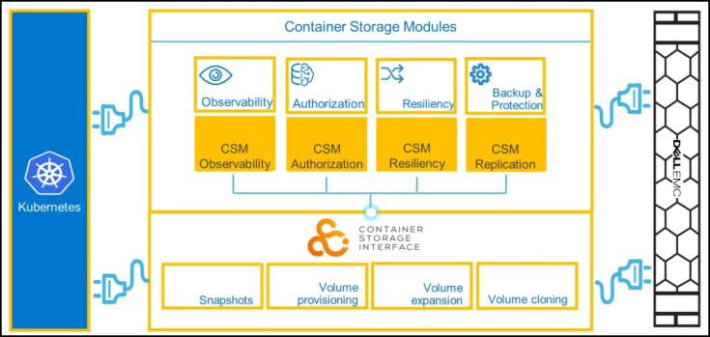
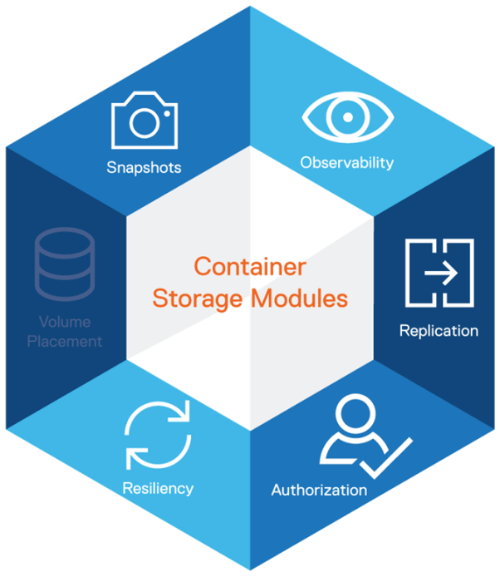
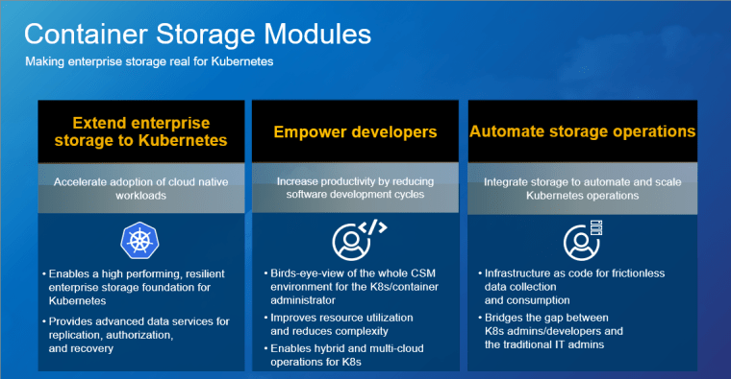
Acknowledgement: Container Storage Modules from Dell®. Image source

Slide 9
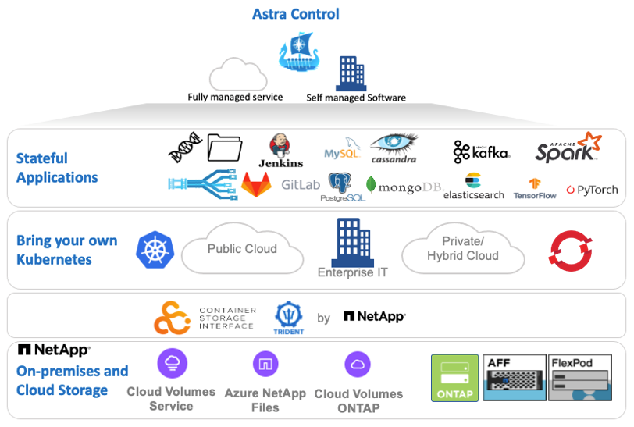
Acknowledgement: Astra from NetApp®. Image source

Slide 10
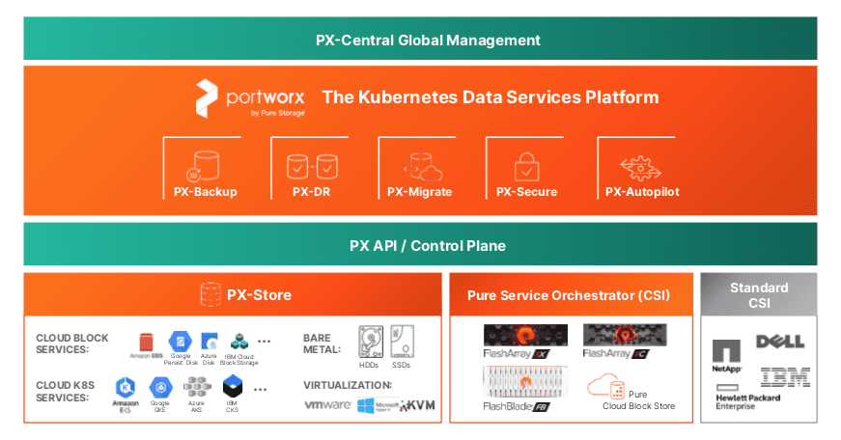
Acknowledgement: Container storage from Pure Storage®. Image source

Slide 11
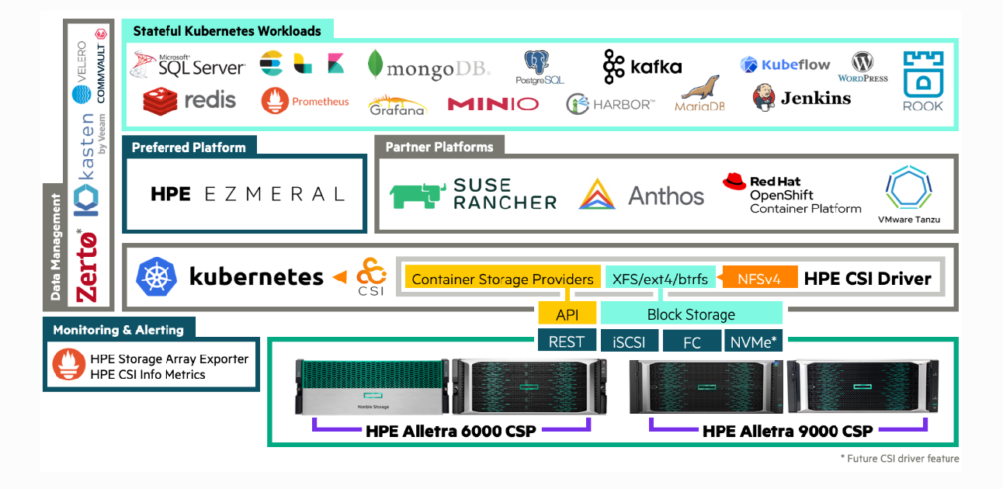
Acknowledgement: Container storage from HPE®. Image source

Slide 12
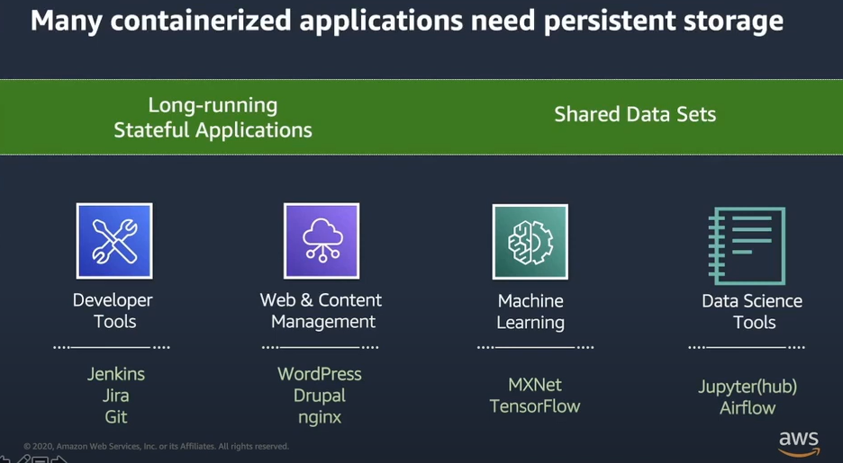
Acknowledgement: AWS EFS container storage from Amazon®. Image source

Slide 13
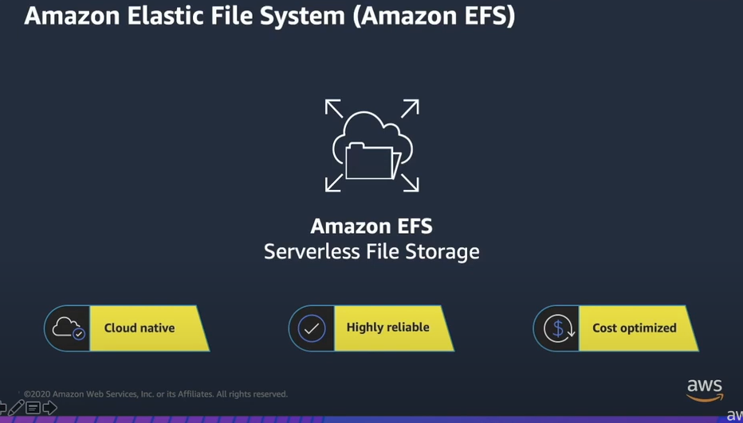
Acknowledgement: AWS EFS container storage from Amazon®. Image source

Slide 14
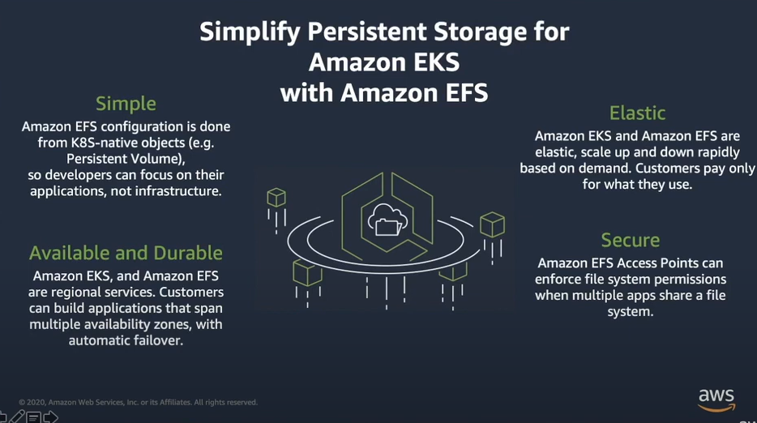
Acknowledgement: AWS EFS container storage from Amazon®. Image source

Slide 15
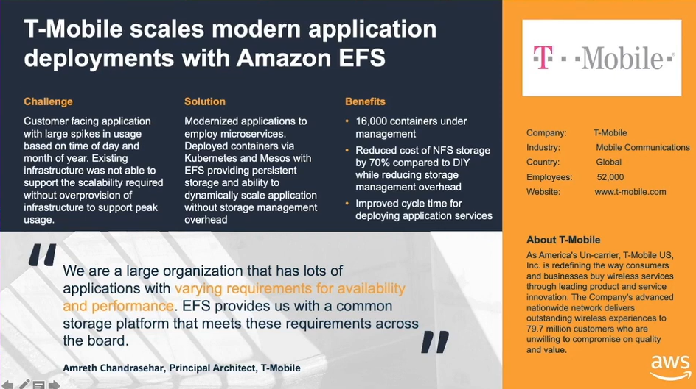
Acknowledgement: AWS EFS container storage from Amazon®. Image source

Slide 16
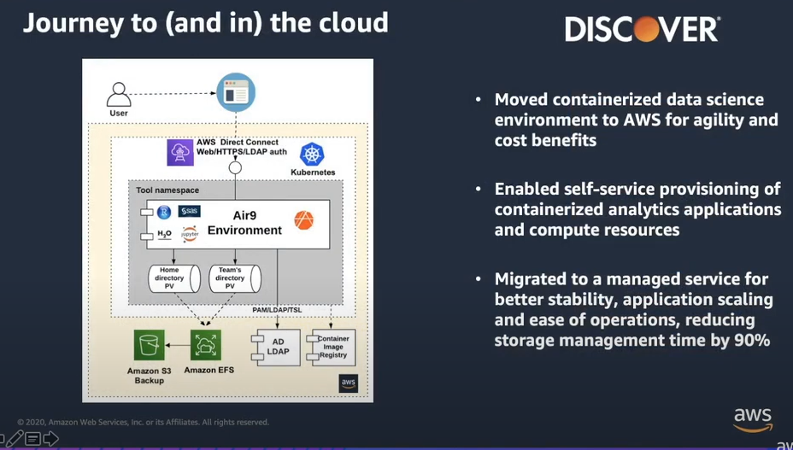
Acknowledgement: AWS EFS container storage from Amazon®. Image source

Slide 17
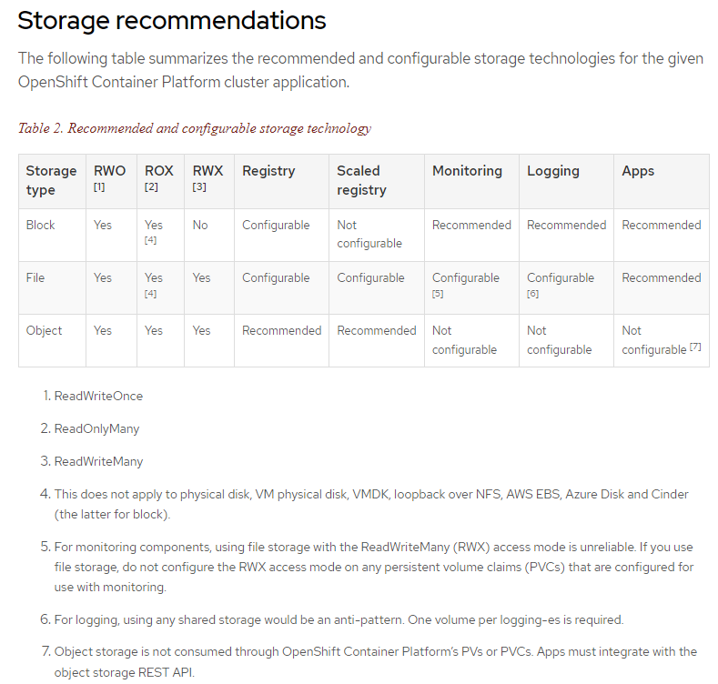
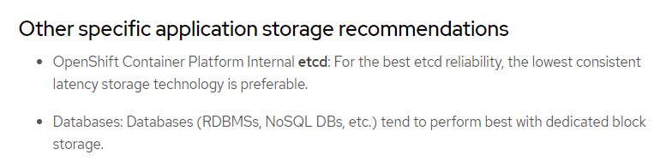
Acknowledgement: Red Hat® OpenShift Optimized Persistent Storage. Image source

Slide 18
Main References
Persistent Storage for Containerized Applications on Kubernetes with PowerMax SAN Storage
OpenShift: Optimizing persistent storage
AWS Container Day - Persistent File Storage for Amazon EKS with Amazon EFS
https://aws.amazon.com/blogs/containers/category/storage/amazon-elastic-file-system-efs/
https://blocksandfiles.com/2021/09/16/googles-cloud-adds-dual-region-buckets-gke-backup-and-ha-for-files/
IDC®-Pure® Whitepaper: Containerizing Key Business Workloads: Meeting End-to-End Kubernetes Data Services Needs for Enterprise Applications
https://docs.netapp.com/us-en/netapp-solutions/pdfs/sidebar/Containers.pdf
https://infohub.delltechnologies.com/p/part-2-the-what-introducing-dell-container-storage-modules-csm/
https://uploads.vastdata.com/2020/08/Katapult-and-VAST.pdf
https://gestaltit.com/exclusive/sulagna/wekaio-makes-significant-enhancements-to-sds-performance-and-capacity-in-wekas-data-platform-for-ai/
https://alibaba-cloud.medium.com/alibaba-cloud-nas-the-one-container-solution-for-cloud-native-technology-8c8b815128bf
https://www.datadoghq.com/container-report/
https://www.alibabacloud.com/blog/alibaba-cloud-cnfs-breaks-the-dilemma-of-container-persistent-storage-for-enterprise-level-cloud-native_598562

